Slide 1
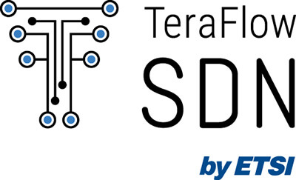





OFC’23 Demo Zone
Slice grouping for transport slices using hierarchical multi-domain SDN control of IP over DWDM
Ll. Gifre, R. Vilalta, J.C. Caja-Díaz, O. Gonzalez de Dios, J.P. Fernández-Palacios, J. Pedreño-Manresa, A. Autenrieth, M. Silvola, N. Carapellese, M. Milano, A. Farrel, D. King, R. Martinez, R. Casellas, and R. Muñoz
lluis.gifre@cttc.es

Slide 2
Introduction
Transport Network Slices
Provide connectivity services between endpoints over a shared underlay network.
Supports definition, monitoring and enforcement of Service Level Agreement (SLA).
Slice Grouping
Use a clustering algorithm to group slices with similar constraints, e.g., capacity, availability.
Optimize the network resource utilization and improve scalability.
Hierarchical SDN controllers
Delegate responsibility of managing specific network domains to specialized SDN controllers.
Ease the adoption of SDN based on a multi-layer and multi-technology approach.

Slide 3

Introduction
ETSI TeraFlowSDN controller (http://tfs.etsi.org):
Cloud-native and microservice-based SDN controller.
Community-driven, open-source, scalable, flexible, and extensible.
Supports multiple technologies and standardized protocols and interfaces.
IP-over-DWDM, Inter-domain, Security, etc.
NBI: IETF L2VPN, IETF Slice, etc.
SBI: OpenConfig, P4, ONF Transport API, IETF Topology, etc.
We showcase the new capacities of TeraFlowSDN to:
Optimize the network resources using Slice Grouping techniques, and
Control multiple technology-specific and SDN-controlled network domains, including IP, microwave, and optical.

Slide 4
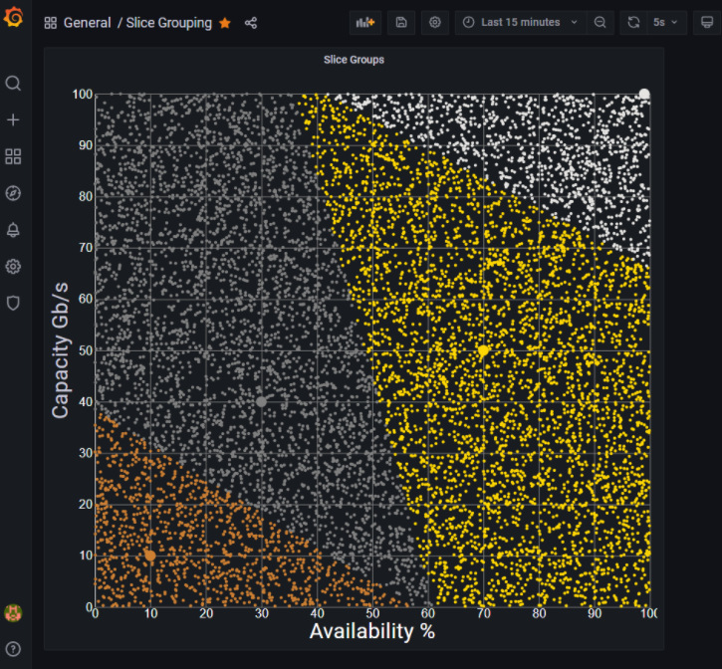
Slice Grouping
{"id": "slice-template-gold", "service-slo-sle-policy": {
"metric-bounds": {"metric-bound": [
{
"metric-type": "service-slo-one-way-bandwidth",
"metric-unit": "gbps"
"bound": "50"
}, {
"metric-type": "service-slo-availability",
"bound": "70%"
}
]}}}
Template | Availability | Capacity
Bronze | 10 % | 10 Gb/s
Silver | 30 % | 40 Gb/s
Gold | 70 % | 50 Gb/s
Platinum | 99 % | 100 Gb/s

Slide 5
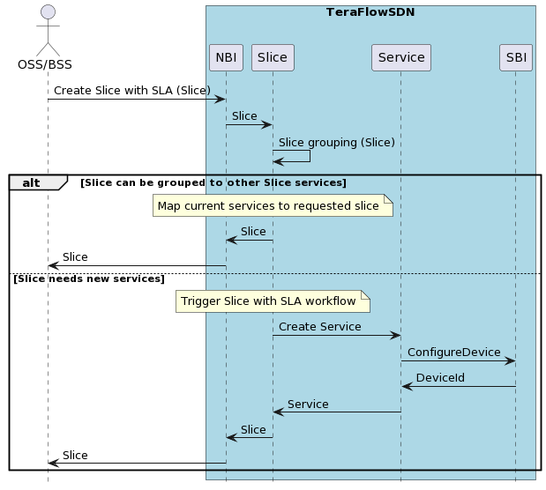
Slice Grouping Workflow
SLICE_GROUPS = [
# Group, Avail., Capacity
('bronze', 10.0, 10.0),
('silver', 30.0, 40.0),
('gold', 70.0, 50.0),
('platinum', 99.0, 100.0),
]
k_means = initialize_kmeans(SLICE_GROUPS)
group = k_means.map_slice(
slice.availability,
slice.capacity_gbps
)

Slide 6



Infinera XR Point-to-Multipoint coherent optical technology
TRADITIONAL POINT-TO-POINT OPTICAL SOLUTIONS
XR OPTICS-ENABLED POINT-TO-MULTIPOINT SOLUTION
ACCESS
COHERENT EDGE
HUB
ACCESS
COHERENT EDGE
HUB
(N+1) x 2 TRANSCEIVERS
N = # of end-points
N + 1 TRANSCEIVERS
N = # of end-points
Simple Optical Combiner
Single High-Speed
XR Transceiver
Numerous Low-Speed Traditional Transceivers
Intermediate Aggregation

Slide 7
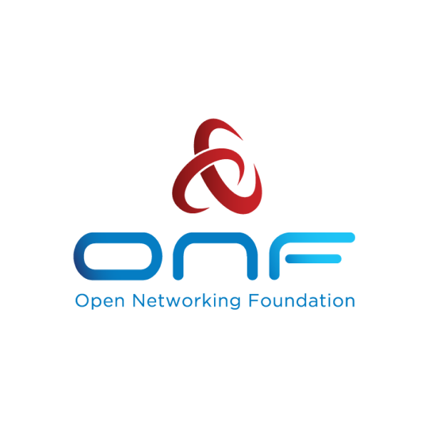
XR Constellation & Optical Domain
IPM
REST-API
Infinera Pluggable Manager
(IPM) controller
Open Line System (OLS) controller
1..16 XR LEAFs
Leaf#1
Leaf#2
Passive Optical Splitter/Decoupler
Optical
Domain
Leaf#3
XR HUB
Leaf#16

Slide 8
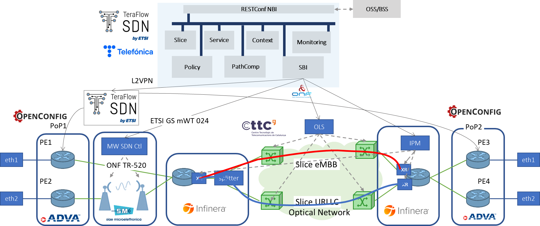
Architecture

Slide 9
DEMO
Try it yourself:
https://labs.etsi.org/rep/tfs/controller

Slide 10

Conclusions
Showcase to the OFC audience a slice grouping mechanism to provide end-to-end SDN orchestration through multiple technology-based SDN domains using the new release of TeraFlowSDN cloud-native controller.
ETSI TeraFlowSDN controller supports hierarchical network orchestration, where a multi-layer and multi-technology transport infrastructure handled by dedicated SDN controllers can be effectively orchestrated.
... if you liked the TeraFlowSDN experience..
Join us! Participation is open to ETSI members, non-members, individual contributors and users… Learn how to join: tfs.etsi.org

Slide 11







This work is partially funded by the EC through the EC/5GPPP TeraFlow (101015857) project, the "RELAMPAGO grant PID2021-127916OB-I00 funded by MCIN/AEI/10.13039/501100011033 and by ERDF A way of making Europe" and finally, the research conducted by 6GMICROSDN-CLOUD - TSI-063000-2021-21 receives funding from the Ministerio de Asuntos Económicos y Transformación Digital and the European Union-NextGenerationEU under the framework of the “Plan de Recuperación, Transformación y Resiliencia” and the “Mecanismo de Recuperación y Resiliencia”.

